Slide 1

6th Grade Math
Unit 12, Lesson 3 Writing Algebraic Expressions Volume 2, pg. 293

Slide 2


Benchmark
MA.6.AR.1.1
Given a mathematical or real-world context, translate written descriptions into algebraic expressions and translate algebraic expressions into written descriptions.
volume 2, pg. 293

Slide 3
Integrated Mathematical Thinking and Reasoning Standards
MA.K12.MTR.1.1 Actively participate in effortful learning both individually and collectively.
MA.K12.MTR.2.1 Demonstrate understanding by representing problems in multiple ways.
MA.K12.MTR.4.1 Engage in discussions that reflect on the mathematical thinking of self and others.
MA.K12.MTR.5.1 Use patterns and structure to help understand and connect mathematical concepts.
volume 2, pg. 293

Slide 4

Learning Target
I can translate a written description into an algebraic expression.
volume 2, pg. 293

Slide 5

Warm-Up
volume 2, pg. 293

Slide 6
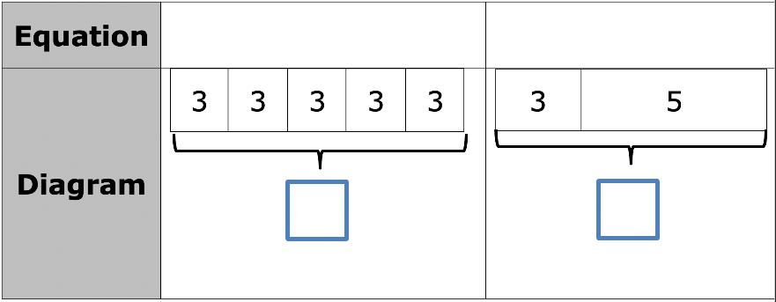
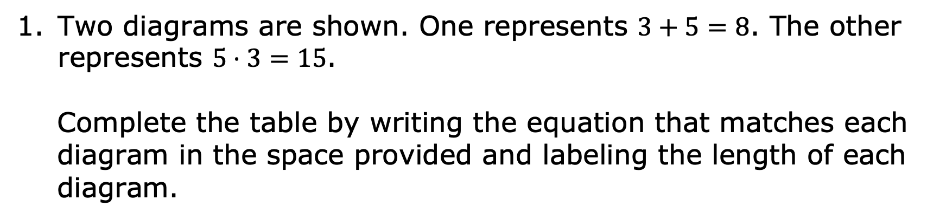
12.3.1 Warm-Up: Bell Work
Two diagrams are shown. One represents $3+5=8$. The other represents $5⋅3=15$.
Complete the table by writing the equation that matches each diagram in the space provided and labeling the length of each diagram.
volume 2, pg. 293

Slide 7

Draw a diagram that represents each equation.
$4+3=7$
$4⋅3=12$
volume 2, pg. 293

Slide 8

Refresher
volume 2, pg. 294

Slide 9

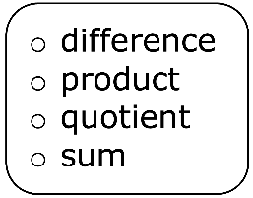

12.3.2 Refresher: Sums, Differences, Products, and Quotients
Complete each statement.
The of $4$ and $6$ is $10$ because $4+6=10$.
The of $8$ and $3$ is $5$ because $8−3=5$.
volume 2, pg. 294

Slide 10
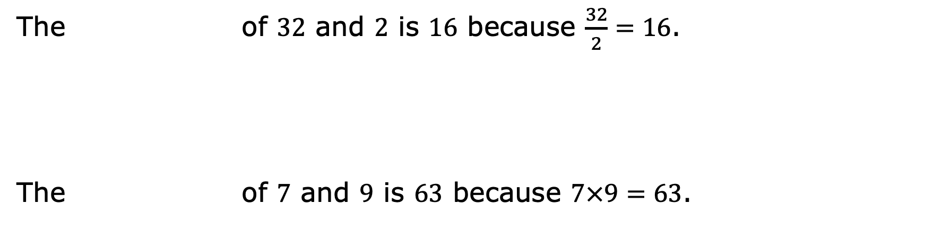
The of $32$ and $2$ is $16$ because $\frac{32}{2}=16$.
The of $7$ and $9$ is $63$ because $7×9=63$.
volume 2, pg. 294

Slide 11

Guided Instruction
volume 2, pg. 294

Slide 12

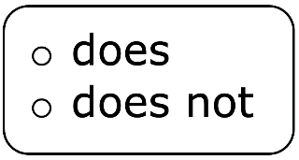
12.3.3 Guided Instruction: Making Sense with Models
An algebraic expression is a mathematical statement containing numbers, operators, and at least one unknown, represented by a variable.
Complete the statement.
An expression have an equal sign or
inequality symbol.
volume 2, pg. 294

Slide 13
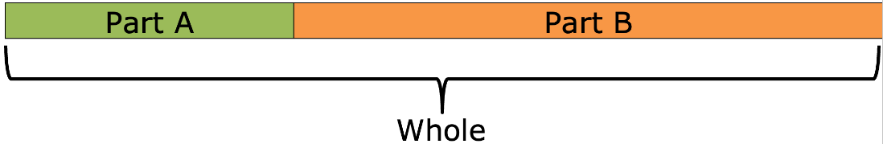
Bar models help connect the action of a problem to an algebraic expression.
Part-Part-Whole Model
The part-part-whole model can be used to show the following actions.
Action | Equation
Combining or joining | Part A + Part B = Whole
Taking away or separating | Whole – Part A = Part B Whole – Part B = Part A
volume 2, pg. 294

Slide 14
“The sum of a number and three” can be shown as the length of the whole bar where one part is 𝒏 and the other part is 𝟑.
The sum of a number and three
$$n$$ | $$3$$
Write an algebraic expression for “The sum of a number and three.”
volume 2, pg. 295

Slide 15
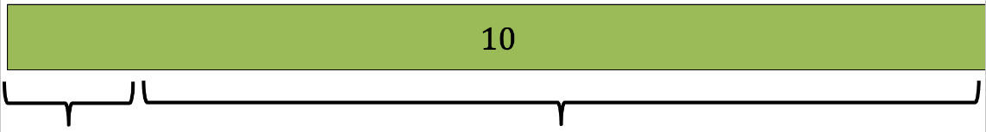

“The difference of ten and a number” can be shown where the whole bar is 𝟏𝟎 and one part is a number represented by a variable, 𝒙. The difference is the other part.
$$x$$
The difference of ten and number
Write an algebraic expression for “The difference of ten and a number.”
volume 2, pg. 295

Slide 16
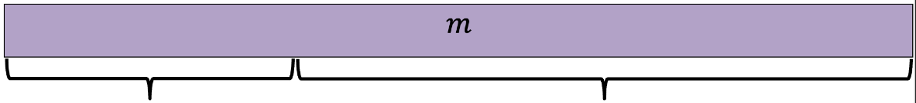

“Five subtracted from a number” is shown with the whole bar as a number represented by a variable, 𝒎, and one part is 𝟓. The other part is the result of 𝟓 being subtracted from the number, 𝒎.
$$5$$
The result of five subtracted from a number
Complete the statement.
The algebraic expression for “Five subtracted from a number, 𝑚” is __________________________.
volume 2, pg. 295

Slide 17
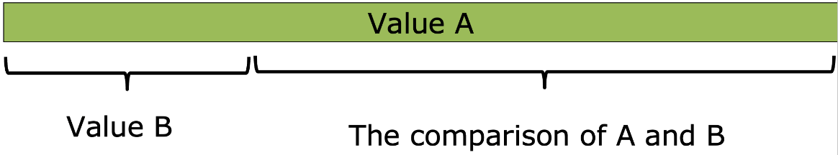
Addition/Subtraction Comparison Model
Comparison models are much like part-part-whole models. They show how much more or less one value is than another.
How much more Value A is than Value B, or
How much less Value B is than Value A
volume 2, pg. 295

Slide 18
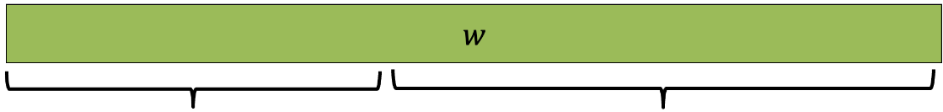

Write an algebraic expression for the bar model shown.
Eight less than a number
$$8$$
Algebraic expression: _____________
volume 2, pg. 296

Slide 19
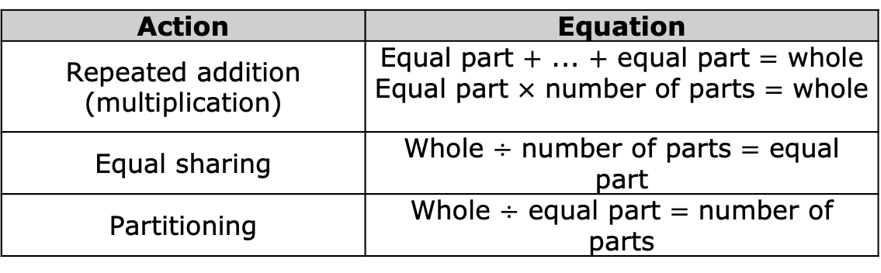
Equal Parts – Whole Model
The Equal Parts – Whole Model shows the whole sectioned into equal parts.
Equal Part | Equal Part | Equal Part | Equal Part | Equal Part | Equal Part | Equal Part | Equal Part
Whole
The equal parts–whole model can be used to show the following actions.
Action | Equation
Repeated addition (multiplication) | Equal part $+$ ... $+$ equal part $=$ whole Equal part $×$ number of parts $=$ whole
Equal sharing | Whole $÷$ number of parts $=$ equal part
Partitioning | Whole $÷$ equal part $=$ number of parts
volume 2, pg. 296

Slide 20
“The product of nine and a number” can be shown as 9 equal parts with size of “a number” represented with the variable, 𝑎.
$$a$$ | $$a$$ | $$a$$ | $$a$$ | $$a$$ | $$a$$ | $$a$$ | $$a$$ | $$a$$
The product of nine and a number
Write an algebraic expression for “the product of nine and a number.”
volume 2, pg. 296

Slide 21

“The quotient of a number and two” could be shown as “a number” represented by the variable, 𝒑, sectioned off into two equal parts. The quotient is the size of each equal part.
A number, $p$
quotient | quotient
volume 2, pg. 296

Slide 22

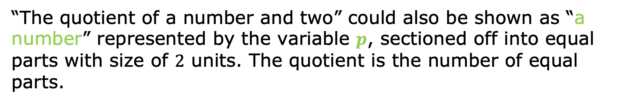
“The quotient of a number and two” could also be shown as “a number” represented by the variable 𝒑, sectioned off into equal parts with size of $2$ units. The quotient is the number of equal parts.
A number, $p$
$$2$$ | $$2$$ | $$2$$ | $$2$$ | $$2$$ | $$2$$ | $$2$$ | $$2$$ | $$2$$ | $$2$$ | $$2$$ | $$2$$
What is the algebraic expression for “The quotient of a number and $2$?”
volume 2, pg. 296

Slide 23

Collaboration
volume 2, pg. 297

Slide 24

12.3.4 Collaboration: Matching Models and Writing Expressions
Part 1
Work with your partner to match each written description to the appropriate bar model, where the red portion is the result of the written description. Some models will be used more than once.
Complete the table with the letter of the appropriate bar model. Then, write the algebraic expression that matches the word description and bar model.
volume 2, pg. 297

Slide 25
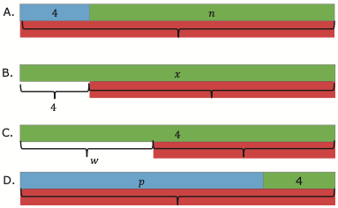
Written Description | Bar Model | Algebraic Expression
The difference of a number and four
Four decreased by a number
Four more than a number
A number subtracted from four
A number increased by four
Four less than a number
The sum of four and a number
volume 2, pg. 297

Slide 26
Part 2
Work with a different partner to match each written description to the appropriate bar model, where the red portion is the result of the written description. Some models may be used more than once.
Complete the table with the letter of the appropriate bar model. Then, write the algebraic expression that matches the word description and bar model.
volume 2, pg. 297

Slide 27
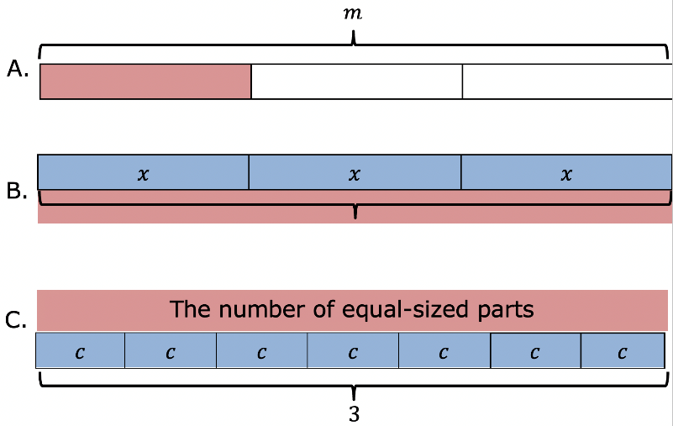
Written Description | Bar Model | Algebraic Expression
A number tripled
A number equally shared into three parts
Three times a number
The quotient of three and a number
The product of three and a number
A number divided by three
volume 2, pg. 297

Slide 28

Guided Practice
volume 2, pg. 298

Slide 29

12.3.5 Guided Practice: Writing Algebraic Expressions from Written Descriptions
Sketch a bar model and write an algebraic expression for each written description.
The product of a number and five
Three tenths less than a number
volume 2, pg. 298

Slide 30
The quotient of a number and twelve
A number doubled
The difference of fifteen and a number
volume 2, pg. 298

Slide 31
Compare your expressions and bar models with your partner. Make any revisions if necessary.
volume 2, pg. 298

Slide 32

Wrap-Up
volume 2, pg. 298

Slide 33

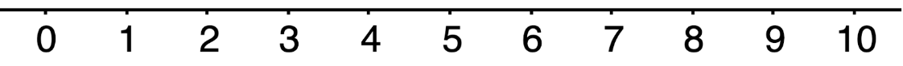
12.3.6 Wrap-Up: Reflection
Choose the emoji that reflects your understanding of translating a written description into an algebraic expression.
volume 2, pg. 298

Slide 34
Complete the statement.
I chose this emoji because ____________________
__________________________________________
__________________________________________
volume 2, pg. 298

